Slide 1

Stick Hero

Slide 2


Using C language…
Stick Hero
An Agile Game
Made by
Group_2

Slide 3
Group Division
延迟符
Void presskey()
Void login()
Main Testing and Debugging
Void move()
Void fall()
Main Testing and debugging
Int max_score()
Void change_score()
Void game()
Void game over()
Vice T&D
Int main()
Void UI()
OB ob_rnd()
Void draw(OB)

Slide 4

Problem Lifecycle
Previous Design
Division of the work
Implementations
Analysis
Future Improvements
Testing/Debugging
Documentation referring
Functions searching
Raise the question

Slide 5
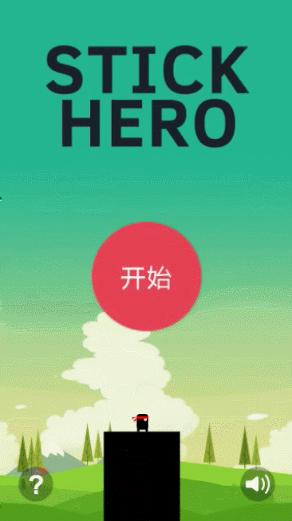
Problem
statement
Using C language to create an interface that allows operator to play an agile game. The hero will go right forward horizontally, there are randomly generated obstacles on the way, the hero goes forward using the stick which is able to lengthen while pressing space key. The stick falls down by pressing enter key. By determining whether the edge of stick falls within the range of the obstacle, the game either continues or ends.

Slide 6
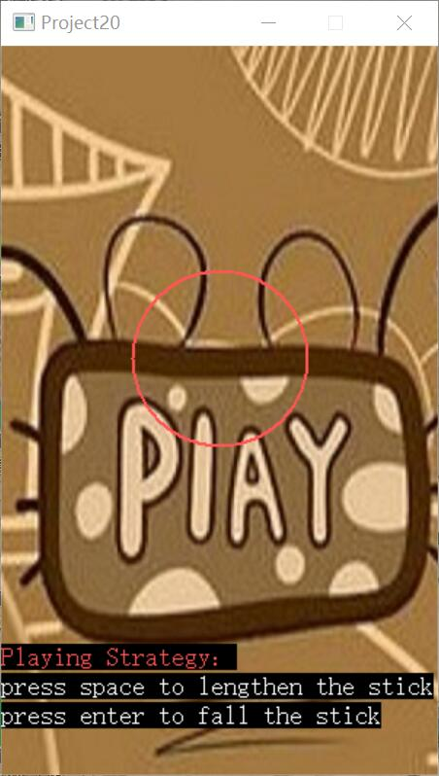

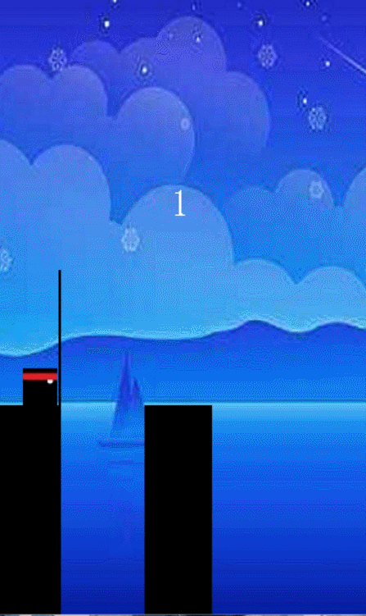

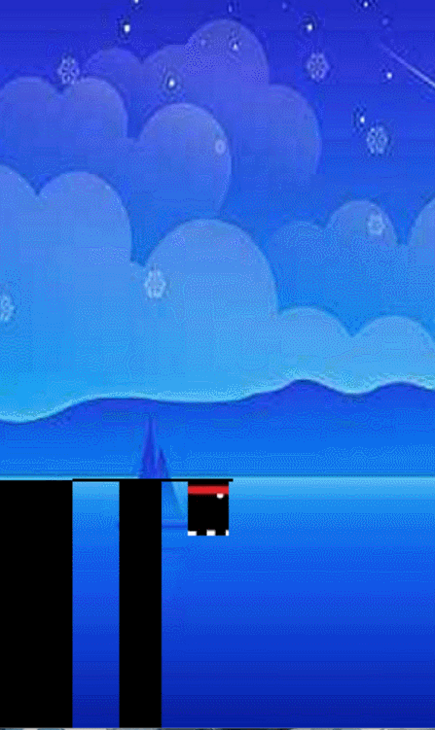
已Analysis Phase
延迟符
Constraint::
-Only when mouse is clicked in assigned region, the game can start.
Requirements:
-Employ a function that can recognize mouse’s click.
-Set background and print instructions.
Constraint：
-Space is the only valid input,when inputting invalid instruct, an error
Is reported.
Requirements:
-Employ a function to simulate the process of stick elongating when pressing space.
Constraint:
-Only enter is vaild.
-Fall the stick without screen flashing.
Requirments:
-Employ a function to simulate the process of stick falling when pressing enter.
Constraint:
-The hero must move to the edge of the stick
horizontally.
Requirments:
-Employ a function to let character move automatically after stick falling.
Constraint:
-Only when losing can the character do free falling.
Requirments:
-Employ a function to judge if hero can pass?
-Judge whether the game continues or not

Slide 7
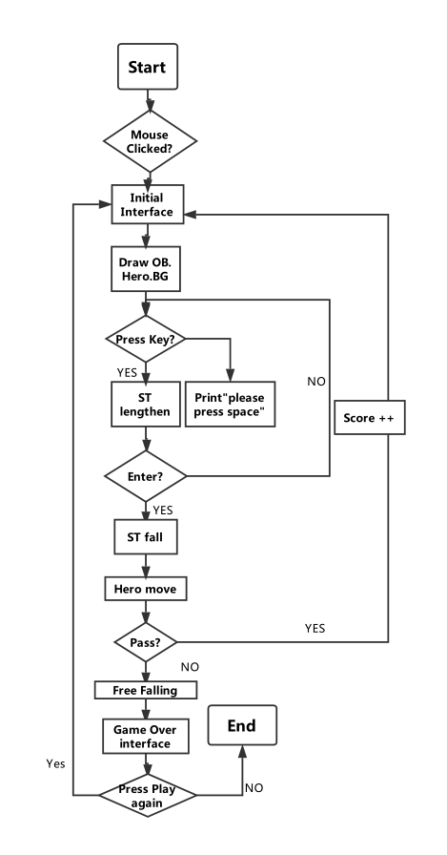
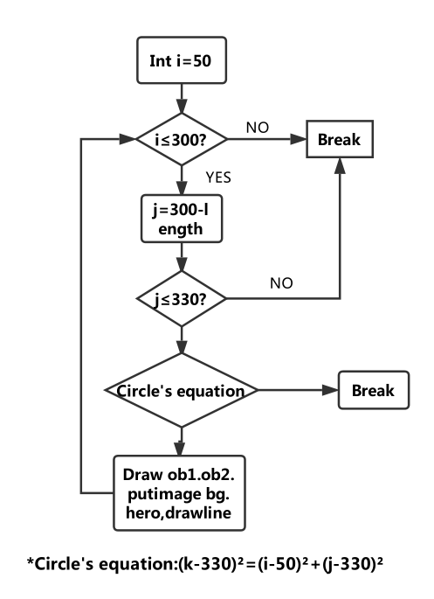
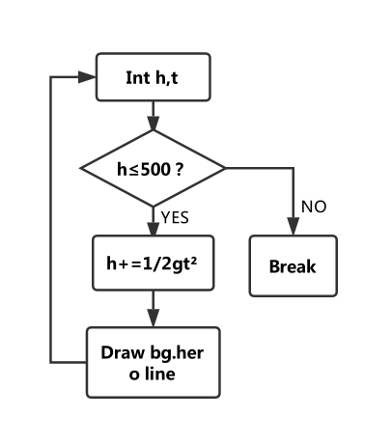
Design Phase

Slide 8
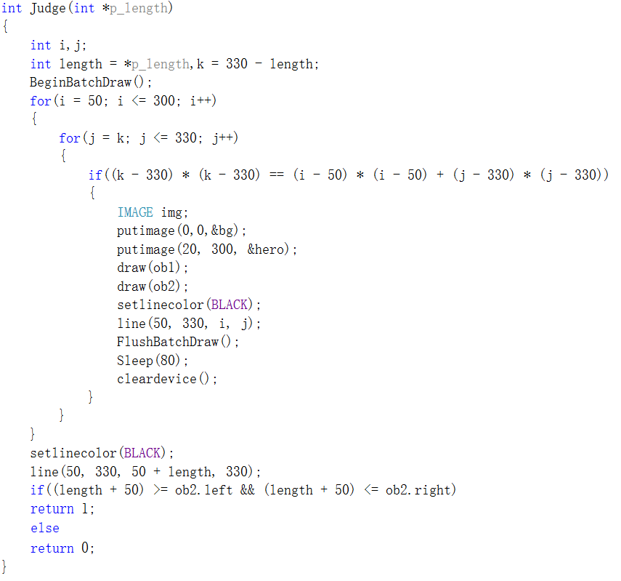
Here is another page of implement2.0 which is concealed
Implement 1.0
Use batch drawing to prevent screen flashing
Use a function to describe the drawing process
Simulating process of the falling stick
Judging whether edge of stick within obstacle region

Slide 9
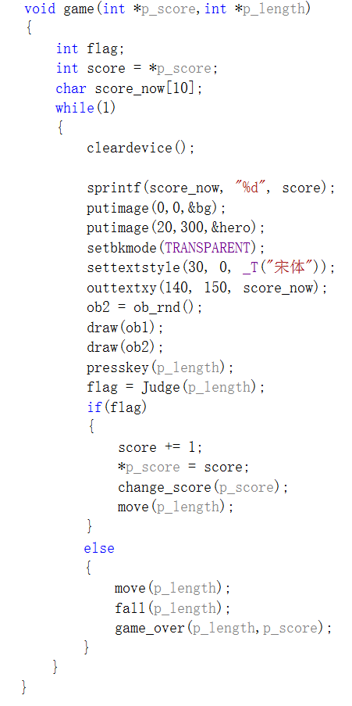
Implement2.0
Save current score
Put image in specified location
Drawing and putting obstacle’s images
Continue or game over?

Slide 10
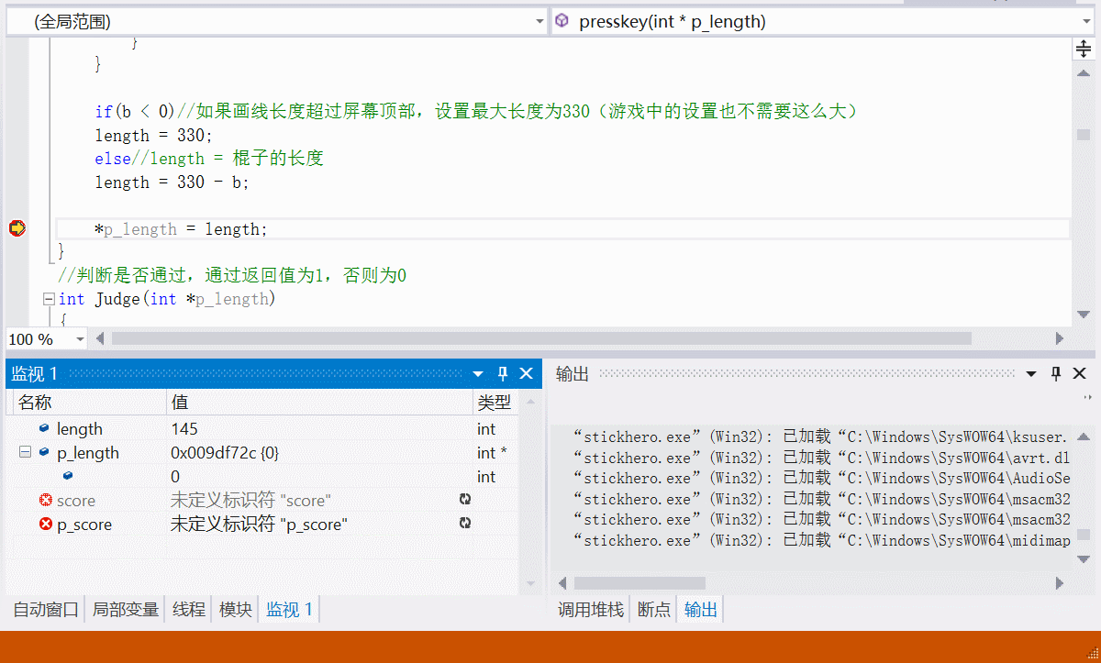
Debugging1.0
Here is another page of debugging2.0 which is concealed
Monitoring the process of the increase of length
1
Send the value of length to p_length in order to avoid global variable
2
Send the value of score so that it can be printed out
3

Slide 11
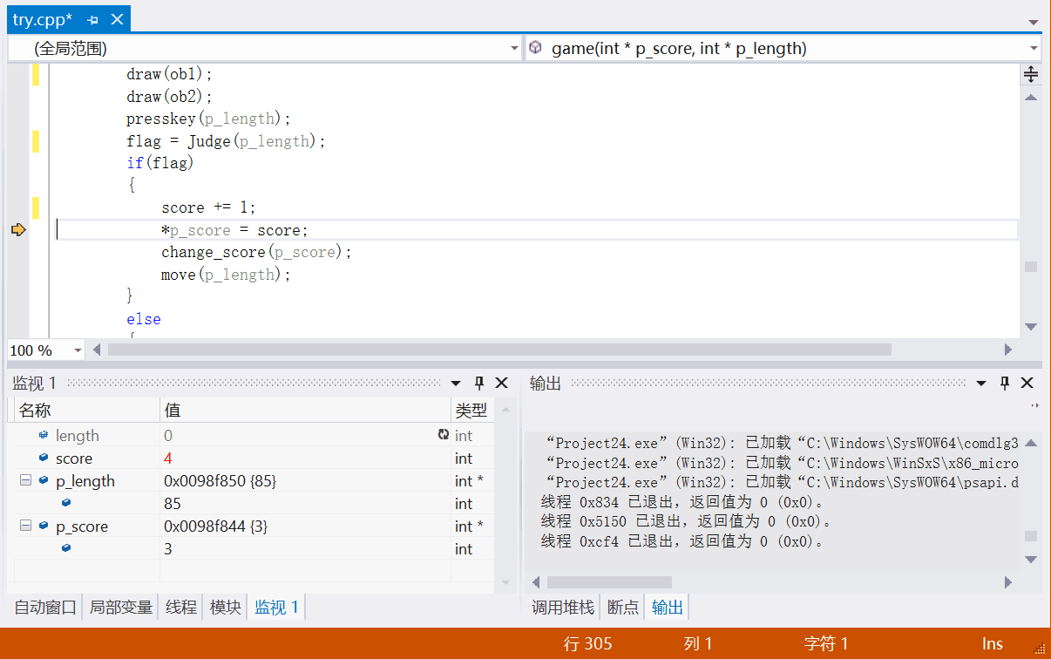
Debugging2.0
Use the debugger to simulate the process of “score++‘’
1
Monitoring sending values to other functional parts like “change_score”;”move”
The feedback is promising.
2

Slide 12
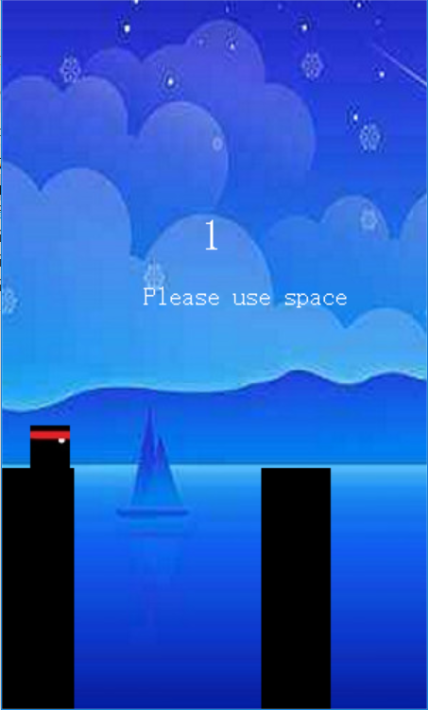
Testing
Press Space
Stick elongating (length+5)
Input
Expect
Reality
Press Key
Start game interface
Press Enter Stick falls (i, j++)
Press Shift (invalid) “Please press space！”

Slide 13
Result&Conclusion
No.1
Understood the basic use of C language, learn some new header files and functions from researching.
Most importantly, we exercised our programing thoughts.
No.3
We learned the importance of cooperating and the mightiness of team working.
No.2
Generally succeeded in manufacturing the game as the one online.Realized our initial ideas in the first place. We shall improve the program to our greatest extents.

Slide 14

Thank You
For listening

